Slide 1
Sentiment Analysis Using a Deep Neural Network
Stephen Frees, Ramiz Midani

Slide 2
Roadmap
Introduction
Methodology
Data
Results
Conclusion

Slide 3
Introduction
A Brief Concept Overview

Slide 4
Why Identify Sentiments
Extract Subjective Information
Is a tweet positive, negative, or neutral
The data was provided in a competition from semEval2017
There were 48 participants, and 38 in this subtask
Notes:
The problem we are trying to solve is to rate social media, like twitter based on sentiments.
Data that would come out as angry or sad would be rated as negative. (excitement, laugh >> positive)

Slide 5
Methodology
Our Tools of Choice

Slide 6
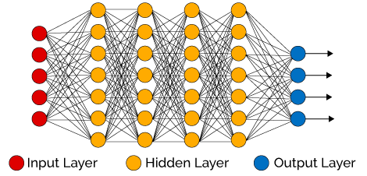
Deep Neural Network
Multi-layered neural network
Can determine non-linear
input/output relationship
Automatically finds complex
feature combinations
https://becominghuman.ai/deep-learning-made-easy-with-deep-cognition-403fbe445351

Slide 7
Closer Look at Layers
For each hidden layer:
Forward pass (y = Wx + b)
Dropout (optional)
Normalization (Instance, Layer, Batch)
Activation function (ReLU)
Finally:
Softmax (loss)

Slide 8
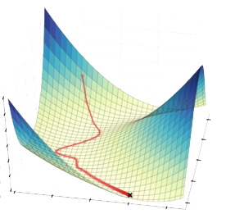
Training
Weight matrices randomly initialized
Compute loss from result
Determine gradient of loss function
Repeatedly update weight matrices
to minimize loss
Stochastic Gradient Descent (SGD)
Adam
Optimized SGD
Momentum
Bias correction
http://dsdeepdive.blogspot.com/2016/03/optimizations-of-gradient-descent.html

Slide 9
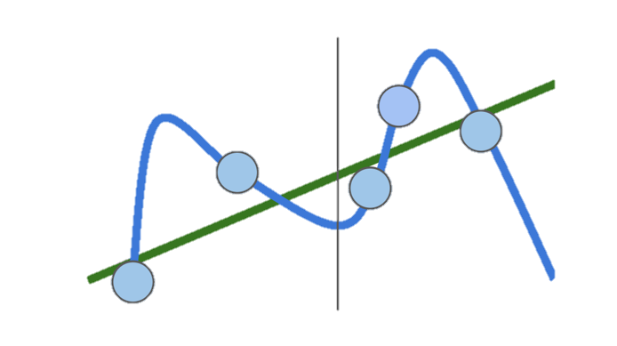
Regularization
Keeps model from “overfitting”
L1, L2 regularization
More complex regularization types
Dropout
Batch/Layer normalization
Etc.

Slide 10
Setting Parameter Values
Improving DNN results is trial and error
9 modifiable parameters
Hidden layer dimensions [150, 150, 100, 100, 50]
Weight scale 2e-2
Regularization coefficient 2e-3
Learning rate 3e-5
Gradient descent algorithm Adam
Dropout No
Normalization Batch
Training time 8 epochs
Batch size 3000

Slide 11
Data
A Closer Look at the Dataset

Slide 12
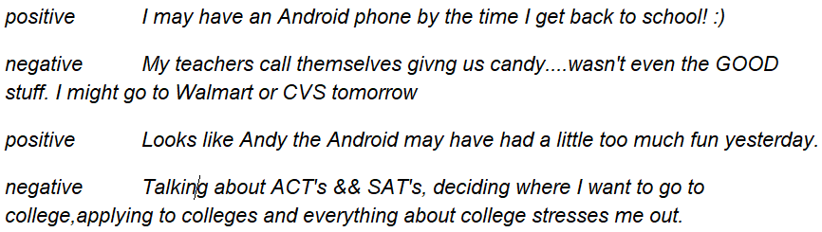
What the Data looks like
Training Datasets
Test Datasets
Labels: Positive, Negative, Neutral
Tweets

Slide 13
What Features Did We Use?
Emoticons ☺ ☹
All caps
Ellipsis
Question Marks
Exclamation Marks
Positive and Negative word lists

Slide 14
Vectorization
DictVectorizer from Sklearn
LabelEncoder from Sklearn
I liked a @YouTube video https://t.co/iCNLpUrduO Nougat 7.1 for Samsung Galaxy Note 4
[0. 0. 1. 0. 0. 0. 0. 0. 0. 0. 0. 0. 4. 0. 0. 0. 0. 0.]
I feel sorry for PM modi! With such supporters he doesn't need anyone else to hurt his image! Not so "right"
[1. 0. 1. 0. 0. 0. 2. 0. 2. 0. 0. 0. 1. 0. 1. 0. 0. 0.]
@jamescharles I'm sorry😕It's not their business-what kind of people are they to wish these things on you that are worse than animal testing
[0. 0. 0. 0. 0. 0. 0. 0. 1. 0. 1. 0. 0. 0. 1. 0. 1. 0.]
Notes:
DictVectorizer turns the dictionary of features into a vector.
LabelEncoder turns the label into a number representation.

Slide 15
Results
Analysis of Our Methods

Slide 16

Our Results
Test set classification accuracy after training: 50% - 52%
Random weight initialization
Random batch selection
Improves on random classifier by almost 20%

Slide 17
Our Results
Raw Text | Gold Label | Predicted Label
Homeopathy can be safely used to treat animals as well as humans. It can be used to treat both acute and chronic... https://t.co/CDUkO9yMK6 | Positive | Positive
@EAAZuz @UN_News_Centre even that carries a responsibility for the LNA to address the issue of human shields. #Libya | Neutral | Neutral
@jamescharles I'm sorry😕It's not their business-what kind of people are they to wish these things on you that are worse than animal testing | Negative | Negative
He is only trying to clean up Philippines. What is death penalty compared to the threat of Islamic terrorism? https://t.co/WZdbR7hnmq | Neutral | Positive
Ukraine tweeter is sarcastic after the EU's Juncker said Poroshenko is to cancel wood export ban. Futuristic pic of… https://t.co/JJWAXmHRIT | Negative | Neutral

Slide 18
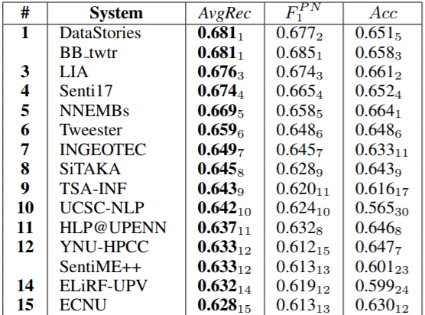
Other Results
Ranged between 33% accuracy to 65%
We would rank the 25th
At least 20 teams used deep learning such as CNN and LSTM
NLTK, Tensor-flow, Weka, Keras
Notes:
Convolutional neural network
Long short term memory

Slide 19
Conclusion
Summing Up

Slide 20
A Look Back
Attempt to analyze sentiment on tweets
Deep Neural Network
Regularization and Normalization
Feature selection and vectorization
Result analysis

Slide 21
Strengths and Weaknesses
Strengths:
Automatic extraction of complex features
Plenty of parameters and optimization options
Feature selection limited only by your imagination
Weaknesses:
Training is time-consuming
Improving result is trial-and-error
Effective feature selection is difficult

